Slide 1
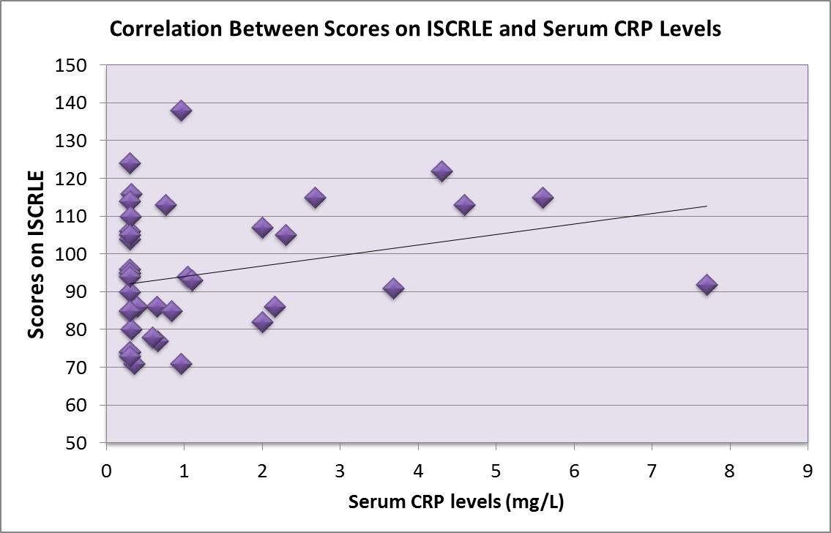
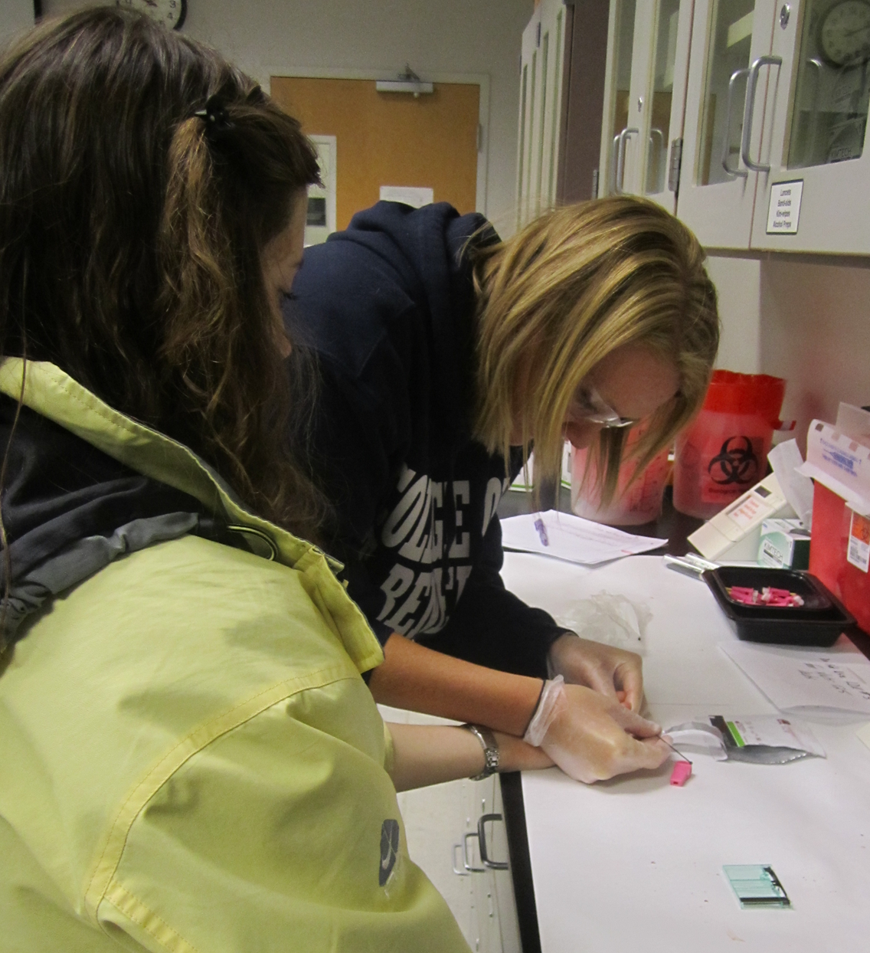
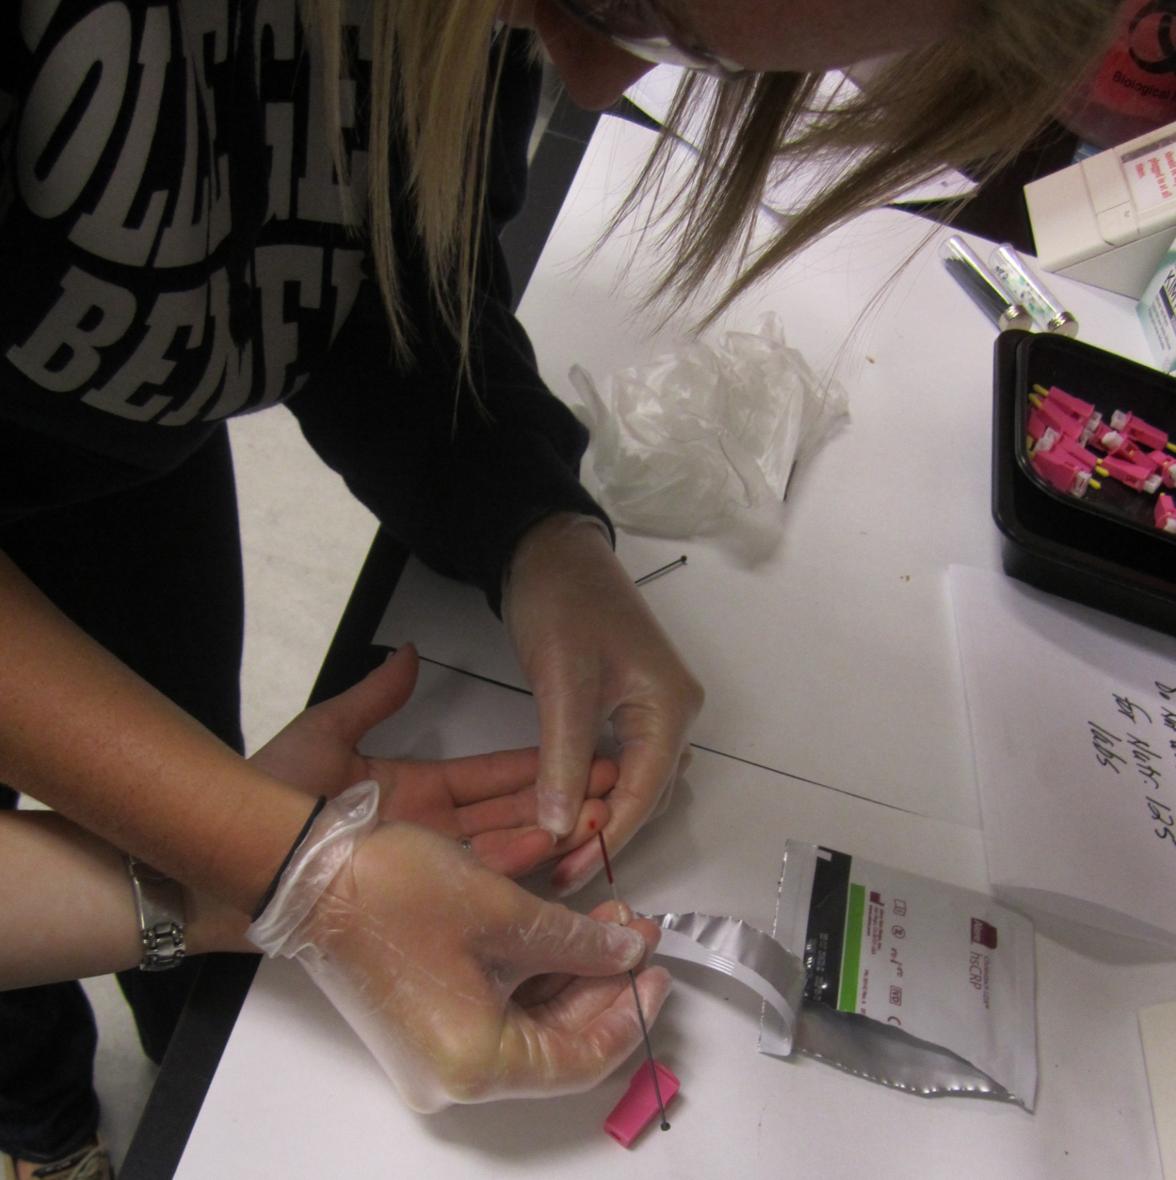
IS THERE A CORRELATION BETWEEN DEPRESSION AND INFLAMMATION IN COLLEGE- AGED STUDENTS?
Jenn Yelle, Cassie Dorschner, Jayne Byrne, MS RD
Nutrition Department
INTRODUCTION
The college population has many stressors in life which can elicit depressive symptoms, such as academic pressures, relationships, and developmental challenges. Depressed individuals have high psychological stress which elevates C-reactive protein (CRP), an inflammatory marker which can be measured through the blood. CRP levels indicate the extent of inflammation and elevated CRP appears to be associated with severe depressive symptoms.
RESULTS
ISCRLE scores indicate levels of depressive symptoms:
< 49: low
50-147: moderate
>147: high
Avg. score of subjects on ICSRLE: 95
Two of the questions on the survey that received the highest average score
Being let down or disappointed by friends
Being ignored
Avg. level of CRP: 1.28 mg/L which indicates moderate inflammation
R= 0.26
PURPOSE
Our present study is intended to determine the extent to which CRP levels are correlated with depressive symptoms in college-aged students.
CONCLUSION
In the college-aged population, there is a moderate correlation between elevated CRP levels and depressive symptoms
100% of participants were in the moderate depressive symptom range as indicated by the ICSRLE
13% of participants had high CRP values (>3.00 mg/L
18% of participants had moderate CRP values (1.00 mg/L-3.00 mg/L)
70% of participants had low CRP values (<1.00 mg/L)
There is a moderate correlation indicated; however, with a larger sample size the correlation would be stronger
METHODS
Approval was obtained from the college’s Institutional Review Board (IRB).
A total of 70 participants were recruited and screened for anti-depressant or corticosteroid use. The sample size for the study was 40 participants.
Depressive symptoms were measured by an online version of the Inventory of College Students’ Recent Life Experiences (ICSRLE).
CRP levels were measured with the Cholestech LDX system using a 40µL capillary blood sample.
Data was analyzed using SPSS software.
 | # of subjects | Min. | Max | Mean | Std. Dev.
CRP (mg/dL) | 40 | .30 | 7.70 | 1.28 | 1.70
ISCLRE Score | 40 | 49 | 138 | 95 | 18
ACKNOWLEDGEMENTS
Thank you to students at the College of Saint Benedict/St John’s University for their participation
Richard Wielkiewicz for statistical expertise
A special thanks to Amy Olson for her guidance through our study
Richard White and the Undergraduate Research Grant
Future research will examine if dietary factors that reduce inflammation correlate to changes in ICSRLE scores

