Slide 1
Librarians and Instructional Technologist Moving Forward Together with Video Classes
Sarah R. Gewirtz, Information Literacy Librarian, sgewirtz@csbsju.edu
Miranda Novak, Assistant Director of Instructional Technology, mnovak@csbsju.ed

Slide 2
Questions:
Where did this start?
How did we redesign video classes to incorporate more hands-on learning?
How did we redesign video classes to incorporate information literacy?
How has this impacted the Librarians and the Academic Technology Specialists?
Notes:
For this presentation we plan on answering the following questions?

Slide 3
Where did this start?
Library Digital Media Support Specialist
Duplicate work with IT
Librarian involvement
Reorganization
Notes:
Media Services was a department in the library that ordered media and equipment, maintained some classroom and conference rooms, and was responsible for campus event support. With the addition of a 3D printer in 2014 faculty interest in using the printer in the classroom sparked a new direction for the department. In July 2015 the Library Digital Media Support Specialist position was created to work directly with faculty to integrate the 3D printer and other technology into their coursework. It was clear very early on that many faculty were not willing or able to learn the technology themselves so Media Services staff stepped into the classroom to teach technology alongside the faculty. At the same time a new IT Director was hired who was interested in having IT move beyond only offering support for enterprise level applications. She saw the Academic Technology Project Leader (IT person) and the Library Digital Media Support Specialist as duplicative and wanted to figure out how to leverage this duplication to provide better support to faculty.
Demand for technology integration quickly exceeded the capacity of Media Services and the single IT staff. Clearly faculty saw value in this work but how to meet the demand? By November 2015 the idea of librarians participating in this work was born. A brainstorming session with all library (including Media Services) staff brought the issues Media was facing with capacity to meet faculty demand to the forefront. In this meeting the idea of librarians becoming more media literate to expand the reach of media in the classroom by teaching technology in classes, while also building in information literacy, seemed like a natural partnership which would strengthen the technology work and give librarians new outlets for promoting information literacy.
Through the 2016/2017 academic year a few select librarians started learning and co-teaching technology in the classroom alongside the media specialists. At the same time the Information Literacy Librarian and the Technology Services Manager (co-supervisor of the Library Digital Media Support Specialist) started talking about creating a rubric for video as a way to gather assessment data.
On August 10, 2017 the Provost announced that Media Services would move from the Library to IT Services.
A reorganization of the department and rebranding as Instructional Technology became official March 1, 2018 under IT Services. A team of four Instructional Technology Specialists were repurposed from their old positions in Media and IT and the Library Technology Services Manager became the Assistant Director of Instructional Technology.

Slide 4
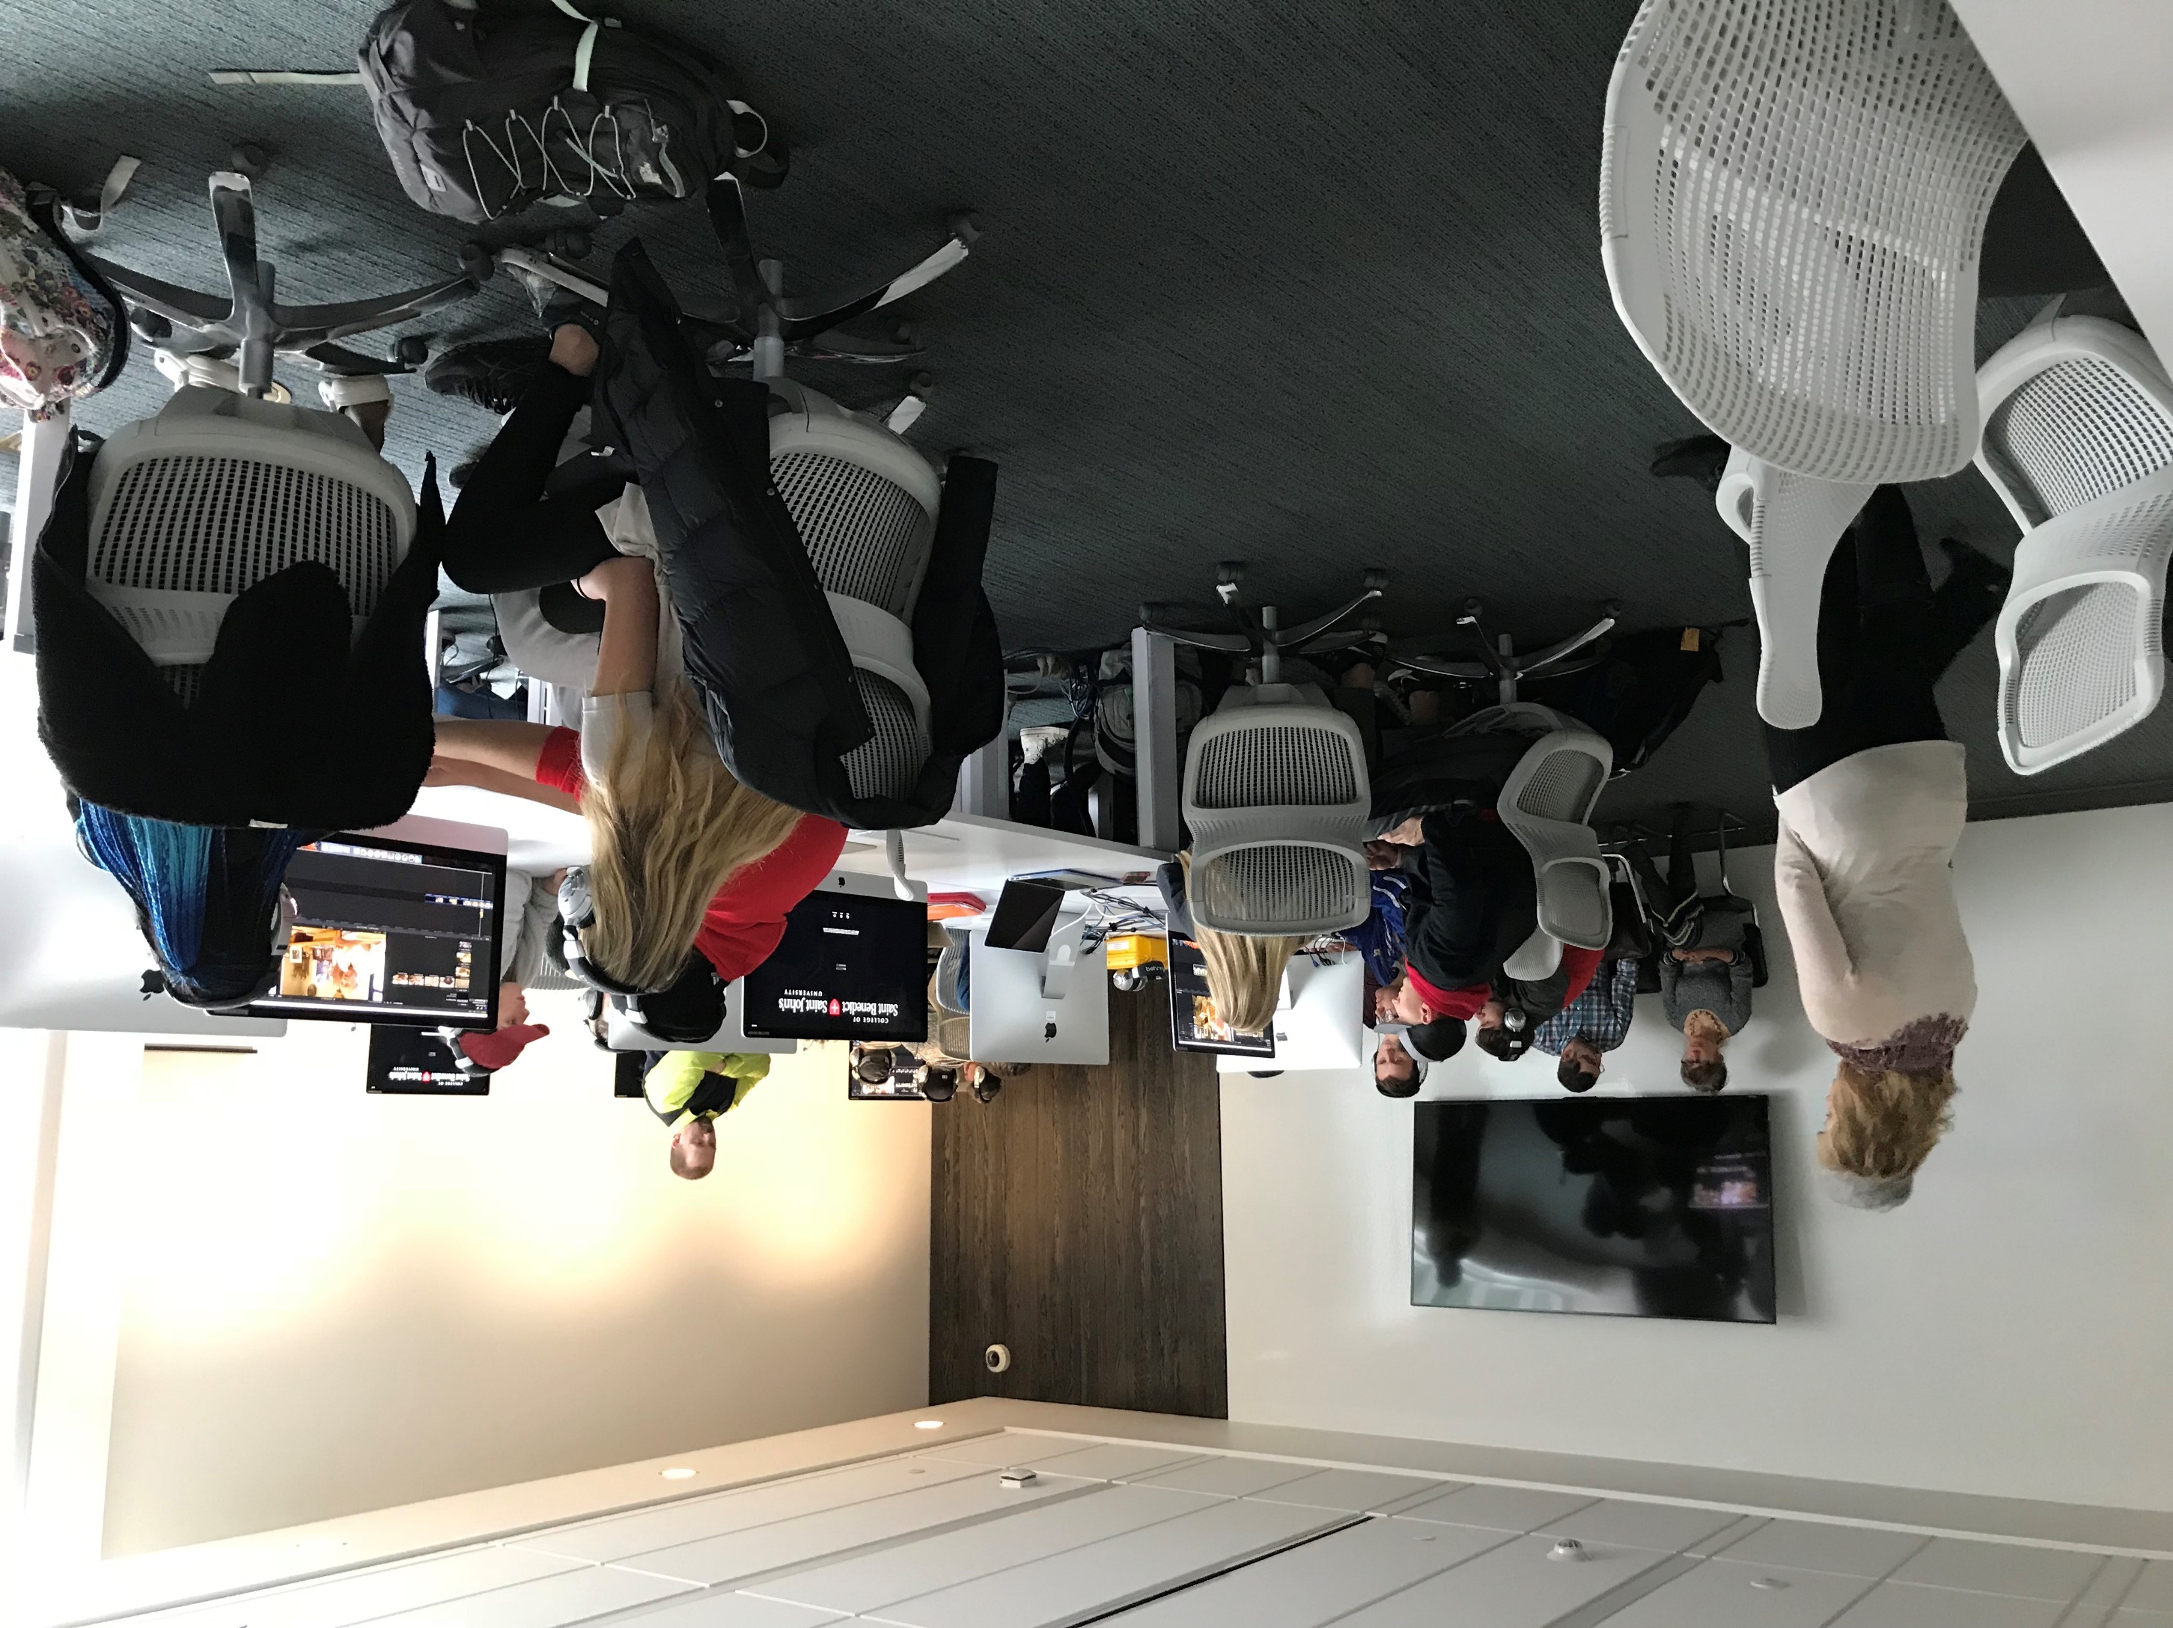
How did we redesign video classes to incorporate more hands-on learning (Fall Semester 2017)?
Flipped Classrooms
Rubric Design
Notes:
While this work started with the 3D printer very soon video assignments became the bulk of the technology integration. Therefore, in the fall of 2017, Media Services decided to try the flipped classroom method with two First Year Seminar or FYS classes. The flipped classroom method was broached as a possible way to meet the demand without adding staff and to also shorten the class periods student spent in video instruction.
The assignment was for groups (3 students in each group) to make a creative and effective argument using video to persuade the audience to pursue a major in the discipline they were arguing for. The proposed length of the videos were 3-5 minutes. The classes met on Tuesdays and Thursdays (80 minute classes) and met with media staff for six sessions.
During this time the Media Services Manager, Digital Media Specialist, Technology Services Manager (Miranda) and the Information Literacy Librarian (myself) met to discuss assessment of student created videos. Media Services could anecdotally let directors and interested parties know about the increased workload they were experiencing as well as positive responses from students and faculty regarding their work but didn’t have any qualitative or quantitative data to support it.
So this all took place prior to the merger announcement.

Slide 5
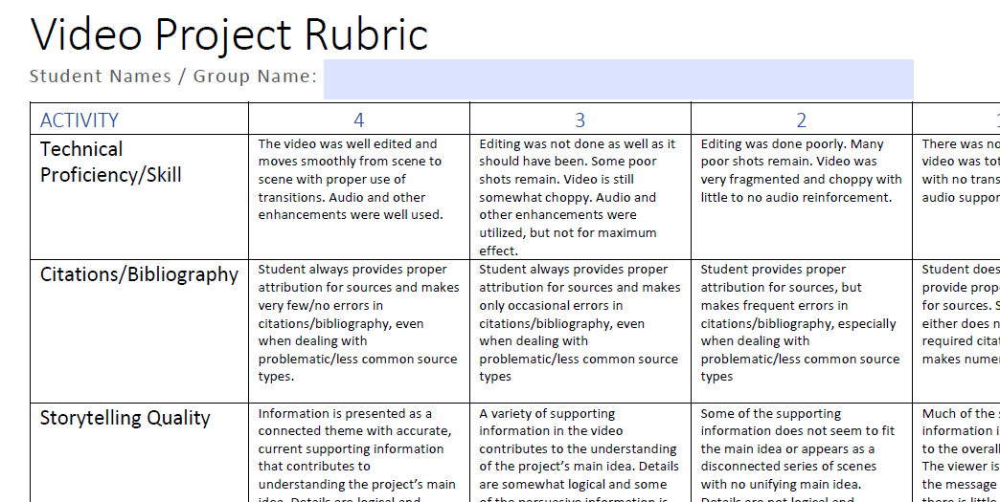
Notes:
Using models found via Google, the group was able to not only incorporate video technical skills into the rubric but also parts of the ACRL Framework for Information Literacy in Higher Education (http://www.ala.org/acrl/sites/ala.org.acrl/files/content/issues/infolit/Framework_ILHE.pdf).
The rubric was designed not only for media services and the librarians but also as a tool to give to faculty. Items on the rubric that were looked at were Treatment, Technical Proficiency/Skill, Citations/Bibliography, Storytelling Quality, Creativity/Critical Thinking, Teamwork, and Timeliness.
The rubric you can barely see is the latest version – and what we used in spring 2018 to assess videos. Minor tweeks were made to it – but it is pretty close to being the same as the used to assess the FYS classes in the fall to see if there was a difference from the flipped classroom model or lecture.

Slide 6
Section A – Flipped
Activity | Group 1 (Econ) | Group 2 (History) | Group 3 (English) | Average
Technical Proficiency/Skill | 3 | 3.5 | 2.5 | 3
Citations/Bibliography | 1.5 | 2 | 4 | 2.5
Storytelling Quality | 2 | 3.5 | 2.5 | 2.7
Creativity/Critical Thinking | 2.5 | 3.5 | 2.5 | 2.8
Section B – Lecture
Activity | Group 1 (History) | Group 2 (Econ) | Group 3 (Econ) | Average
Technical Proficiency/Skill | 3.5 | 3 | 3.5 | 3
Citations/Bibliography | 2.5 | 2.5 | 2 | 2
Storytelling Quality | 3 | 4 | 3 | 3
Creativity/Critical Thinking | 3 | 3.5 | 3 | 3
Notes:
Using the new rubric there was little difference between the two classes. The slight differences could be due to group dynamics, time and effort spent on the project, etc. I think if we didn’t move to the flipped classroom model in spring 2018, we would have had to look more into it.
Some patterns emerged, though. Students had difficulty with citing. One group did get a 4 but in many ways they shouldn’t have. Based on comparisons with the other groups, they gave us information as to where they found the facts stated in the video and at the end they listed all the sources they used. However, the sources were not in any type of citation format (MLA, APA, Chicago). The fact that many of the other videos did only part of their citations correctly was why this group stood out for being more complete.
Storytelling Quality and Creativity/Critical Thinking was stronger in Section B than in Section A. Again, this could be due to the reasons listed earlier: group dynamics, time and effort spent on the project, etc.
It did become clear that the librarians could play a bigger role in helping with video production classes. Media staff focused on teaching the technology whereas the librarians could discuss the storytelling quality and creativity/critical thinking part of the production. Our librarians have experience asking questions that would help students to think critically about the project they were producing. Questions like: what is your topic? What type of sources are going to be needed? Is that an appropriate source? What question are you trying to answer with your project? Our librarians could help students with in-text citations as well as creating their bibliographies.
Furthermore, librarians have experience teaching and think of themselves as teachers. Media staff needed to move away from the technology-side of instruction, and instead of thinking of themselves as “trainers” begin thinking of themselves as “teachers”. The goal by incorporating more librarians into the teaching was to help staff in media services to begin to think beyond the technical issues and more about the critical thinking needed to complete a video project and help them begin thinking of themselves as “teachers”.
I do want to point out that some of this information was presented/discussed by media staff but did not contain the information literacy component; it wasn’t as flushed out as it would be if a librarian were present.

Slide 7
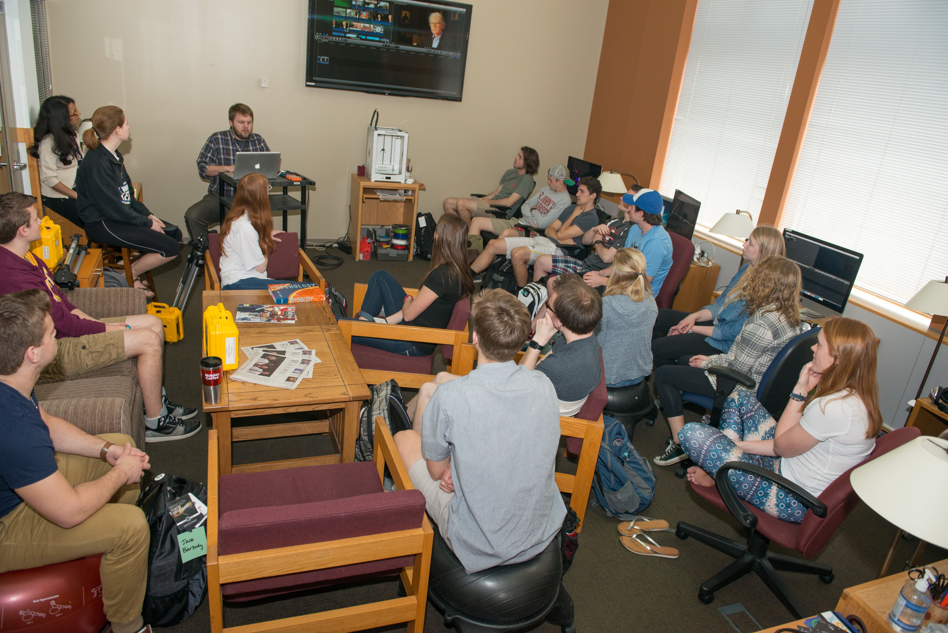
Feedback:
Instructors
Students
Faculty
Notes:
Flipped Classroom Method Feedback
Overall the media services instructors felt the flipped classroom method was a positive experience. One reported that, “It was very rewarding…I was able to spend more time with students discussing their project rather than re-training them on Final Cut Pro (our video editing tool) because they didn’t pay attention [during the standard class (lecture)].” (Akkerman) Furthermore, the instructor stated that he was less stressed using this method and also felt that students stress and anxiety levels seemed lower.
Both instructors noted that:
Students felt more prepared. Students were engaged with the tool and each other. Students would refer back to the training video if they had a question, and trained each other by working more closely together. They felt that students asked less questions yet questions they did ask were clearer. Additionally, they felt they were able to accomplish more in a shorter period of time which allowed the students to begin working with the equipment earlier than the students in the lecture-style class.
Students overwhelmingly preferred active hands-on experience after watching the Final Cut Pro video instead of a standard lecture class. Students experimented more with Final Cut Pro and there was less of a learning gap between students and the resource. Other comments from students: I think that one way to strengthen the learning, would be to have a structured review session at the beginning of class the day after we watched the video. This would remind us of all the main points of final cut pro.
It would've been nice to get a little refresher in class, because I forgot exactly how to do some things even though I had watched the video the night before.
Faculty feedback was positive. The faculty member noticed increased engagement and effectiveness of the flipped classroom method. He loved it and plans in the future to have all his students use the flipped classroom method when they have a video production class. His recommendation was for media services to use this approach going forward.

Slide 8
Spring Semester 2018
Observations
Questionnaire:
Staff were new to teaching video classes:
What has been done very well during the video training sessions?
What could be improved?
If you could change one thing it would be…?
Is there anything else you think I should know?
Interviews:
Staff currently teaching:
Overall, how was the shortened class experience?
Did you feel you had enough time to cover the “important ideas”?
What weren’t you able to cover (larger items)?
Did students seem engaged? Confused? Did they ask good questions?
How about the faculty? What were their reactions?
Notes:
During the 2018 spring semester, I spent time observing video classes to find out what was being taught (what information was being provided); how the classes were designed; and, how faculty and students were understanding the information presented. Questions were sent and answered by staff who were new to video classes and I interviewed two media staff who had shortened classes.
Feedback from staff new to teaching:
They did well with getting buy-in from students and instructors on the value of utilizing video as an expressive means to present an issue or describe an event.
Improve: We need to still improve upon upgrading the “academic content” of the videos, such that students are using arguments supported by documented evidence, intentionally chosen artistic/aesthetic effects to affect the viewer, and/or using specific scenes and clips to document events.
Change: Have a consistent outline to use for each training session.
It will be great when we have clear instructions on attribution and credits, and that all faculty know to include that as they develop their assignments. I think it would be good for professors to be consistent as well – and this could be communicated when setting up the classes. They should have a good timeline for students, set goals/purposes of the project and make the instructor’s contact information available so students know who to contact in case of questions.
Interviews:
Both instructors felt that they had enough time to go through the material even though the class was shortened (instead of six one met with class 3x’s for 80 minutes; other met with class once for 1 ½ hours). They both felt that the students seemed engaged and asked good questions. Both felt that we could move from 6 class sessions to 3 or 4 class sessions.

Slide 9
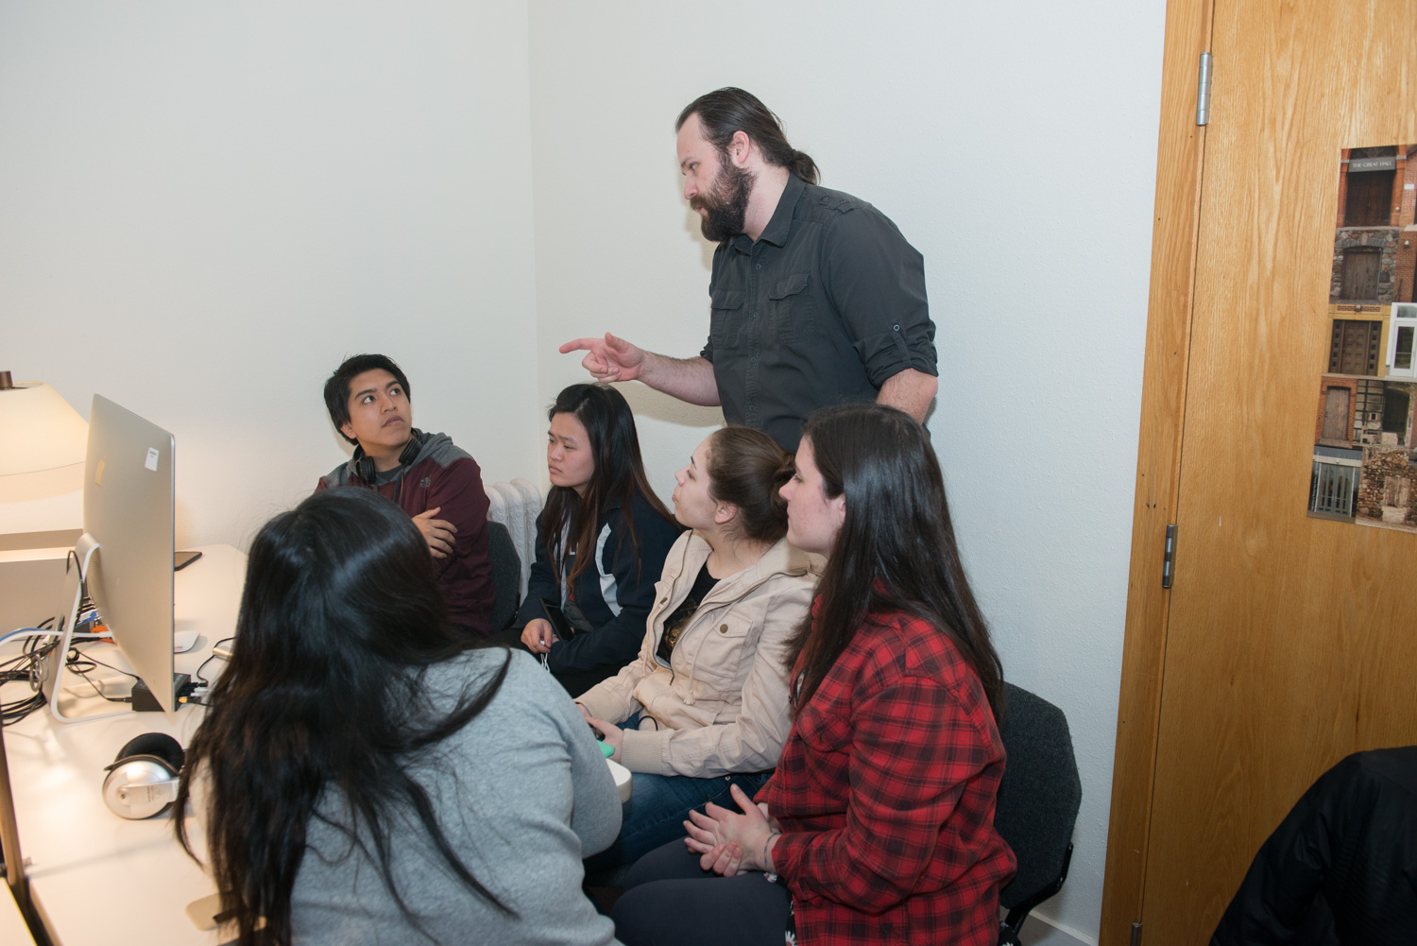
How did we incorporate information literacy into video classes?
Pre-class (15-20 minutes):
Class 1:
Class 2:
Class 3:
Class 4:
Notes:
Once I had all the information, my goal was to redesign the video classrooms to incorporate information literacy but to also give faculty time back and have students do the work outside of class. I felt that if classes were shortened to 4.5 sessions instead of 6 it also meant more time for additional classes to be taught.

Slide 10
Pre-Class & Class 1:
Pre-class (15-20 minutes):
Review Assignment with students and discuss due dates with
What is the difference between a research paper and a video project?
Treatment – have student explain assignment and discuss when it is due
Class 1:
Treatment
Students present their video idea and get feedback from faculty, peers and Instructional Technologist/Librarian
If students need sources – how do you evaluate sources?
Citations – what citation style are you using? What do you cite and where in video?
Bring class back for discussion/questions
Show videos (good) of student projects (if requested by faculty)
Notes:
Pre-Class should be a discussion of the assignment and due dates with the students (approved by faculty prior to class). Engage the class further by asking them if they’ve ever done a video project – what did they do? Ask them about the process – what steps did they take to create the video? Ask the class what type of software, camera, etc., they have used in past projects.
Have a discussion of the difference between/similarity with writing a paper vs. producing a video. What is the difference? Can someone tell me? What is needed to write a paper? Story? Resources (books, articles, websites, data, statistics)? What is needed to create a video? Story? Resources (books, articles, websites, data, statistics)? What message are you trying to convey to your audience?
Students would then receive the treatment [a document that defines the video’s concept and summarizes the approach to be taken] which asked questions like, “who is the director?” “Producers?”, What is the purpose?”, “Who is your audience?, “Describe the content of your video.” During the next class period they would spend time talking about their ideas.
Class 1:
A small discussion should be done regarding evaluating sources since many will need to incorporate a variety of sources to complete their video assignment (see Appendix E). Since it had become apparent that students do not cite their information correctly (if at all) time must be spent in getting them to understand the importance of this and how to do it correctly. If they do it for a research project why wouldn’t they do it for a video project? It was suggested that over the summer, a template would be created that students could follow when citing sources properly in their videos.
At the end of class, bring the students back together for a discussion and questions period.

Slide 11
Class 2:
Show video of bad camera techniques; have discussion
Camera techniques
Have students get in their groups and work with cameras
Hard drive explanation as place to save files
Bring class back for discussion/questions
1 Week Later- During this time students should capture video for their project.
Notes:
This class will focus on student’s understanding and learning how to use “the tool” (camera) as well as giving them hands-on time to work within their groups to capture video, audio, etc. Instructors should walk around asking student questions, answering student questions, and offering feedback. A hand-out(s) for the camera, one-third rules, etc. was to be developed over the summer.

Slide 12
Class 3:
Prior to class, students’ are given a purposeful questionnaire for students’ to take answer when watching the Final Cut Pro video.
Final Cut Pro
Review – how to find it; a few things to help them get started
Review files on hard drives
Students use video captured for their project to begin working with Final Cut Pro
Bring class back for discussion/questions
1 Week Later – Students work on their video project
Notes:
Instructors should review key concepts from the Final Cut Pro video that students watched ahead of their class meeting. Students should come to class ready to start editing the footage they captured from the week before. Instructors need to walk around and answer any questions that may come up.

Slide 13
Class 4:
Review videos – get peer, faculty & instructor feedback
Remaining time – students continue with videos
Notes:
This is time for students for to get feedback from their peers, faculty and class instructor.

Slide 14
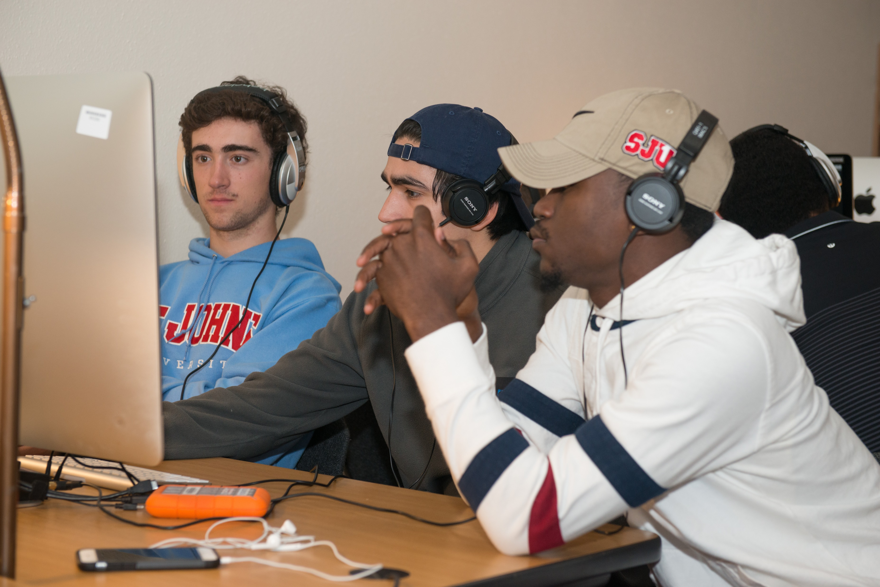
How has this impacted the Librarians and the Academic Technology Specialists?
Instructional Technology Specialists
Librarians
Notes:
The report I wrote was the basis for discussion through the summer on the video sequence or the class design which drives what gets taught in the classroom. The teaching of video is, by its nature, hands on but we are still working to incorporate information literacy hands on activities.
Instructional Technology Specialist were most comfortable with a tech-heavy 6-class-day format which allowed very little time for information literacy. Through the summer the discussions between the teams, where Librarians weighed in and asked that goals be introduced to frame the process in the higher-level learning outcomes that emphasize critical thinking and ethnical use of information, helped make some headway.
In addition to talking about the layout and content of classes the summer was also spent learning together. Learning the “other” language. Librarians learning the tech while Instructional Tech needed to learn the very basics of library resources, information literacy language, and what learning outcomes do to shape what happens in the classroom.

Slide 15
How has this impacted the Librarians and the Instructional Technology Specialists, cont.?
Podcasting sequence
Culture of assessment
Use of library resources
Increased understanding of critical thinking in projects
Notes:
This semester instructional technology is piloting podcasting projects with select faculty. The close working relationship with librarians means that they are now helping build the sequence (i.e. the outline for the project) and ensuring that sufficient attention is given to the critical-thinking aspect of the assignments rather than focusing too heavily on the technical aspects.
Working with the librarians has taught Instructional Technology about the value of assessment. This was a major shift in thinking but has been essential to the future of the department as we work to expand the number of classes we’re involved with. If we can’t prove that we’re effective, faculty won’t be interested in working with us.
The library is able, through this work, to utilize some of our online video resources more fully than we’ve ever been able to before. We found a number of vendors were eager for us to direct students to their resources and even use them in their videos. Vanderbilt TV-Archive and Alexander Street Press in particular were happy to give us permission for students to take clips and use them to support their arguments. This gives us real scenarios in which to talk about the importance of citation and fair use and allows our students to use primary sources in ways they haven’t done before.
The Instructional Technology Specialists are experts in the technologies they teach and the Librarians are experts in information retrieval, evaluation, and information literacy. Each team has been able to share their expertise with the other to help create assignments that push students to think critically about their topic. Projects that were, at the beginning, simple reports and travelogues are becoming more evaluative. Together the teams are starting to share vocabularies so they can start to set common goals. There is a shared understanding about the purpose of this work and it is focused on the intellectual content rather than the technical proficiency.

Slide 16
Questions?

Slide 17
Stats:
Notes:
There were 30 classes during the 2015/2016 academic year taking advantage of this collaboration, 45 in 2016/2017 and 44 in 2017/2018. Sustainability was a concern already in the first year. So far in 2018/2019 there are 58 classes scheduled and Spring classes haven’t been committed yet. With our new curriculum in the planning stages we expect the faculty demand to grow and the partnership between Instructional Technology and Librarians allows us to meet the demand while ensuring that the values of the library carry forward in this new medium and students learn how to find and use sources just as they would for a traditional research paper.

